Slide 1
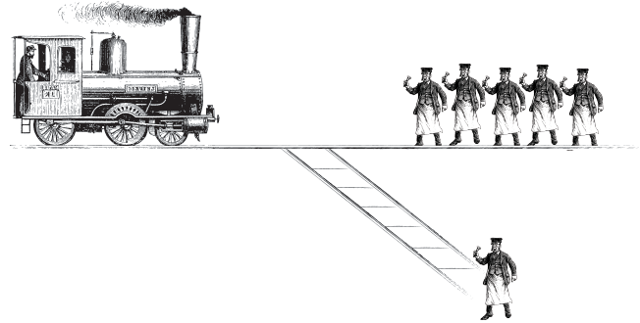
Trolley Problem: A Thought Experiment

Slide 2
What is the thing called Ethics?
Einstein says: ‘I do not believe in immortality of the individual, and I consider ethics to be an exclusively human concern with no superhuman authority behind it. Relativity applies to physics, not ethics.’
Background: Methodologically Ethics differs from Science since Ethics studies values, whereas Science invokes evidential facts. Secondly, Applied Ethics is a religion-free discipline that supervenes on the rational and responsible agency.
MORALITY (Having to do with moral values)
Descriptive Prescriptive
Factual (Is) Value (Ought)
See, David C. Stove, ‘On Hume’s Is-Ought Thesis’, Hume Studies, Vol 4, No 2, 1978, 64-72.

Slide 3
Moral Ethics
Ethics is the study of moral judgments of human beings and non-human beings and the environment.
Morality identifies in ascribed some informal conducts and particular codes that are mutually followed by a group of people and other members of the society from a rational and reasonable common ground by applying moral rules, ideals, good disposition to avoid harm, evil or wrong to the society or human beings, non-human beings and environment .
The parameter of morality depends on the universalistic sense that is called the prescriptive model of morality. Hume believes that the prescriptive term ‘ought’ can not be deduced from the descriptive premise like ‘is’ that seems more factual.
This looks a flawed theory For example: ‘Any immoral act is punishable’ or so on.
See, David C. Stove, ‘On Hume’s Is-Ought Thesis’, Hume Studies, Vol 4, No 2, 1978, 64-72.

Slide 4

Moral Agent
1 2
3
Moral sense Responsibility
A morally responsible person truly holds an individual moral agency and collective agency together. (Chakraborty, 2018)

Slide 5

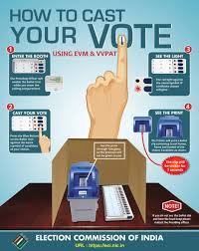
Whether Morality is Subjective or Objective? Context sensitive Non-context sensitive (Rigid Rules)

Slide 6
Subjective ground of Morality
Moral values seem subject-centric as they depend on the agent's rationality and moral choices, and it can differ according to different person’s intentions, motivations, interest and choices. Subjective value is reliant on our method of valuing or judging it. Actually, subjective morality is more close to context-sensitivity or culture relative.
Because a subject can accept a moral judgment as to right or wrong in a particular time and context, but with the changing of time and context, they may catch the same moral judgment in their own way.

Slide 7
Objective ground of Morality
Moral values are objective because these are valued cum agreed upon by all people across many cultures. Objective moral values have general applicability like ‘How to cast your vote’.
The object-centric morality gives importance to the ‘universal’ paradigm of a moral judgment. The believers urge that if a person performs a particular action for a specific situation and behaves in a particular way, then in all cases, where the situation remains unchanged, the person would behave in the same way. Here we try to move from particularity to universality.

Slide 8
Ethical Accounts
The ethical theories seem the theoretical accounts of what ethical thoughts are in practice to justify our moral actions.
We have different moral conjectures: Amoralist, Deontology, Utilitarianism, Virtue ethics, Pragmatism, Animal ethics, Feminist ethics, Environmental ethics, Business ethics etc.
A) Meta-ethical account:
Meta-ethical account studies the existence of moral values from realism and anti-realism levels.
Q: Are moral values subjective or objective?
B) Epistemic account:
Epistemic account deals with the conjectures of moral theories and their critical justification in our knowledge systems.
Q: How do we know the justified moral values?
C) Language centric account:
Moral values cope with the analysis of moral language (the language of moral).
Q: Are moral values descriptive or evaluative?

Slide 9
Moral Realism vs Anti-moral Realism
What is Realism: Realism is a doctrine about the nature of existence. The world consists of the object that are totally mind independent.
The traditional realism grants the naiveté of meaning, i.e. meaning of a word is a property shared by all the objective things denoted by words. Putnam tries to summarize this thinking in this way: ‘Traditional forms of realism are committed to the claim that it makes sense to speak of a fixed totality of all ‘objects’ that our propositions can be about.’ Even realism also suggests that theory of truth and reference presupposes that there is a metaphysical harmony between thought and world.’ (Hilary Putnam, The threefold cord mind, body, and world, Columbia University Press, New York, 1999, p.7.)
What is Anti-realism: There is reality but the reality is partly constructed by our conceptual schemata. They discard the conception of ready made world or god made world. In a reply to Blackburn Putnam writes: ‘It is we who divide up ‘the world’- that is, the events, state of affairs, and physical, social etc, systems that we talk about- into ‘objects’, ‘properties’, and ‘relation’, and we do this in variety of ways. ‘Object’, ‘entity’, ‘property’, (and ‘relation’) have not one fixed use but an ever-expanding open family of uses. Because ‘exist’ and ‘entity’ are conceptually linked, the same is true of ‘exist’.’ (Hilary Putnam, ‘Replies to Simon Blackburn’, from Reading Putnam, edited by Peter Clark and Bob Hale, Blackwell, Oxford, 1995, p, 243.)

Slide 10
Moral Realism: Moral facts are there and our moral judgments regarding the moral facts can be turn out as true and false. We can find out the truth value of the moral facts. Moral judgment actually expresses cognition.
Moral anti-realism: We can not judge the truth value of the moral facts since there are no moral facts. Moral judgments only express our emotional attitudes. Though our moral judgment aims at holding truth but its failed because of there are nothing in moral judgment that can correspond to the moral prediction in objective level.

Slide 11
Good: Different Moral Aspects
Dr. Sanjit Chakraborty

Slide 12
Can we teach children to be good?
Memory
Encoding Storage Retrieval
* Here in our childhood days, learning morality relates to values that merely have the fact-centric judgment. It's only encoding and storage-centric learning. Bring moral values in the moral fact centric judgment is a process of retrieving your encoding memories.

Slide 13
Logical Distinction of Good
Is good a linguistic concept (Fact centric/properties based) or a mental entity (value centric)? It is a debatable query.
The grammatical use of good instigates a logical distinction of good from two diversified levels.
Good, according to grammar is called an adjective.
So, from a logical sense, we can qualify the criterion of good from two different adjective levels:
An attributive adjective of good
A predicative adjective of good

Slide 14

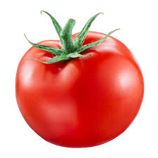
An attributive adjective is something where we attribute an adjective to the noun. For instance,
A red jacket.
A predicative adjective is an adjective that becomes the predicate form of the sentence like:
This jacket is RED or This tomato is RED.
How could logically predicative attribute be possible?
If we can transmit logically attribute adjective (A) into two separate split predications, then it will turn out as a logical predicative attribute.

Slide 15
Aristotelian sense of good as category can be differed like Good student, Good teacher etc.
Peter Geach (‘Good and Evil’, Analysis, 17, 1956) raises the distinction of Attributive good and Predicative good.
A red rose. (A G)
That is a rose and it is red. (P G)
* What is an adjective?
An adjective qualify a particular characteristic to noun.
For instance, Honorable President, Brave Soldier etc,.
When an adjective follows be verb (am/is/are/was/were/will be etc.) as a linking verb, it is called a “predicate adjective”. For instance,
This building is huge/ A prolific academic career.

Slide 16

For example:
‘An A B’, here an A (RED) is the attribute of B (jacket).
Here the predicative adjective plays as follows:
“Is a B” and “Is A” as the predicative adjective form is “is an A B”.
Comparison:
A GOOD FOOTBALLER (AG)
He is a footballer and he is good. (PG)
But some attributive terms like big or small cannot be placed in the split manner. Example,
X is a big fly cannot split into the sentences “X is a fly” and “X is big”.

Slide 17
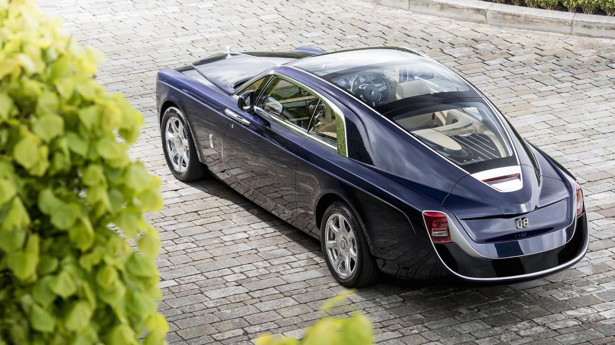
Why good cannot be alignment?
‘Whatever is SUITABLE for A needs to be good for A’ cannot be always justified.
We cannot demand that a “black car” would be the “good car”.
The moral simplicitor of good and bad would be for the proper names.
Ali is good or Ram is good or Sweptail Rolls Royce is good.

Slide 18
Objectivist’s outlook on Good
Objectivists argue that there is an ambiguity in using the ordinary use of the term good or bad. In the case of selective uses, good does not apply any ordinary natural thing that can be descriptive in nature, but it indeed implies a kind of indefinable non-naturalistic attributes.
The philosophers ask bravery or blueness as an attribute to understand the predicative adjective such as blue or brave. Here the philosopher tends to espouse good or goodness from the non-naturalistic attribute, not as a naturalistic attribute like redness, sweetness or softness etc.

Slide 19
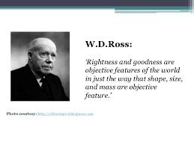
Oxford’s moralists
The oxford’s moralists bring the idea of good from a positive paradigm of objectivity like W. D Ross* and H.A Pritchard**.
They consider that ‘this is a nice movie’, i.e I as a subject recommend you to see the movie since it looks nice to me.
Like the news paper reports “Kohli was batting on a good wicket”, here Oxford’s moralists will also find a choice or recommendation from the subject’s level as the conception of the good wicket is a subjective choice able notion or recommended wicket for the batsman that does favour for their batting.
Ross> "What Renders a Right Act Right?”
Pritchard> "Does Moral Philosophy Rest on a Mistake”?

Slide 20
Professor Prichard (Duty and Interest, p. 17) says: "When Plato raises the question 'What is justice?,' he does not mean 'What do we mean by the terms "justice" and "just" '?" "If he had meant that, he would have been raising what was only verbally, and not really in practice.
We have long practice to be moral. And so called moral theories intend to guide us.
He also writes:
Moral Philosophy is meant the knowledge which would satisfy this demand, there is no such knowledge, and all attempts to attain it are doomed to failure because they rest on a mistake, the mistake of supposing the possibility of proving what can only be apprehended directly by an act of moral thinking.
(Pritchard, “Does Moral Philosophy Rest on a Mistake?, Mind, 1912)

Slide 21
One can argue to this sort of recommendation process of the fan/cricketer or the subjective sense. One can get the meaning of the evaluative term ‘good wicket’ without being engaging with cricket more.
Oxford’s moralists argue that the conception of good doesn’t have the objective force in principle. A cricketer is good if they can skilfully play cricket, but a doctor is good if they treat their patient well. So the attributive quality that makes a cricketer good differs from the attributive quality that makes a doctor as a good doctor.
So, good for them don’t preserve any proper descriptive force.
No one definition can define all the things are “good and so and so”. Good must have certain commendatory, but not any descriptive force.

Slide 22
Good as comparison form
The qualified good can be a comparison to the other things.
Here the meaning of the whole sentence would be determined through what has been placed in place of X. For example, “A GOOD X”.
You can see the functional comparison or the merit-centric comparison or quality-centric and so on. The boundary would be very extensive and abstract too.
The criterion of value can make an object a good thing.

Slide 23
Functional aspect of good
R. M Hare, in his work Moral Thinking (1982), induces the functional aspect of good. He emphasizes the idea of a good mobile that may function well. So, we can consider the concept good from the meaning of its function or see the efficiency level.
Something is good only if it functions efficiently.
Here we are talking about the function of a noun.
But all these look context-specific.
There are non-functional nouns like “sunset” that seem good in the sense of the function as a commendation.
For R. M Hare, to commend or prescribe something is to mention as being good to the appliers. Good for us is the primeval general adjective for commendation.

Slide 24


Philosopher’s call “Inverted commas use” centric assessments like “the sunset was looking awesome, but I felt too cold” may be an egocentric/subjective commendation.
GOOD
Good for the subject Good for all

